Slide 1
NLP Week7

Slide 2
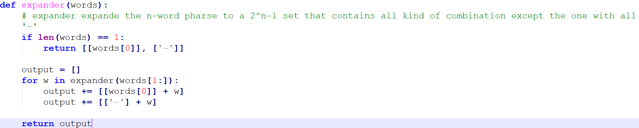
Mapper

Slide 3
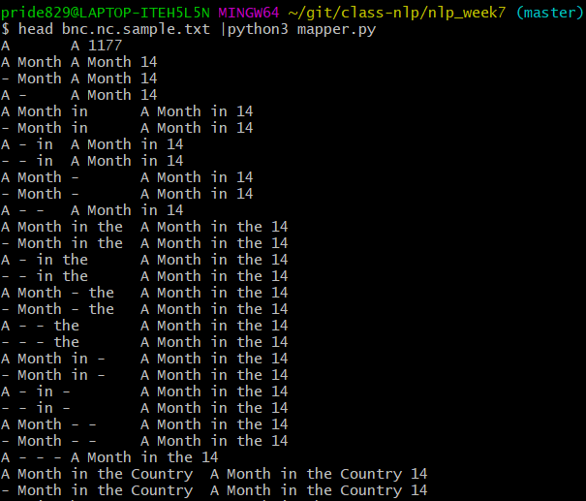

Slide 4
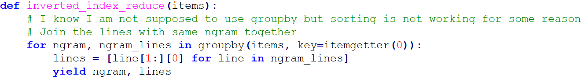

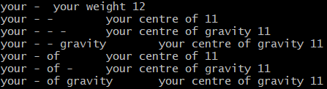
Reducer

Slide 5
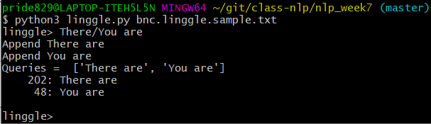
Linngle
All symbols are parsed and added to the original queries.
Parse the queries until there are no symbols left.

Slide 6
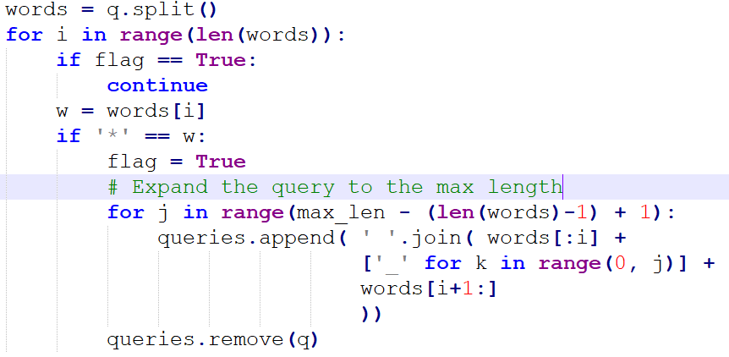
Linngle - *
Calculate the max-length of phrases and expand the queries.

Slide 7
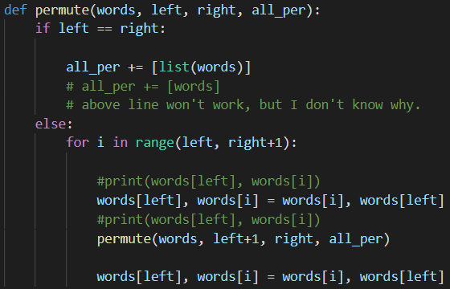
Linngle – {}
Use recursion to list all permutation of given words.

Slide 8
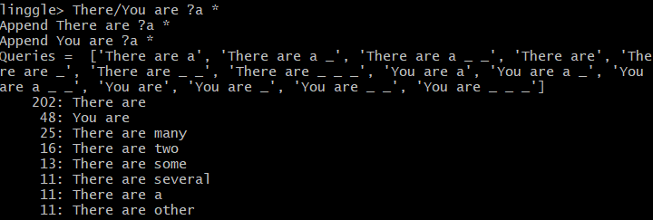
Linggle
Multiple symbols in one sentence supported!

Slide 9
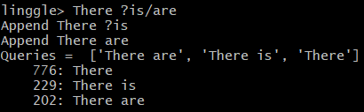
Linggle
Multiple symbol in one word supported (for limited situation..)!
In fact, only ? and / are supported.

